Slide 1
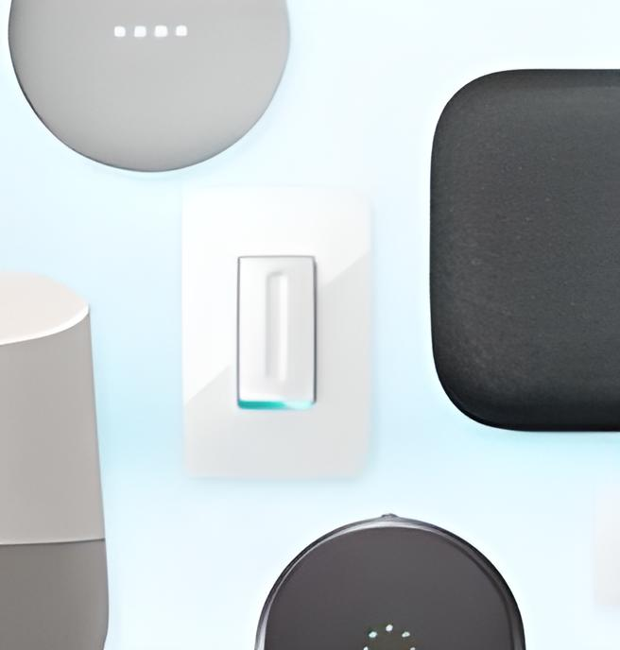

Bella Beat's Case
Study: Analyzing
Smart Device
Usage Data
We explore how non-Bella Beat smart
devices are being used and how we can
apply these insights to Bella beat's products.
by Aritra Basu
19-04-2023

Slide 2
Top Trends in Smart Device Usage
1
2
3
Connected Fitness
Home Automation
Virtual Assistance
Smart devices are
commonly used
for tracking fitness
data including
steps, workouts,
and sleep patterns.
Smart devices are
being used to
control home
appliances, lighting,
and security
systems.
Many people are
now using smart
devices to access
digital assistants like
Amazon's Alexa or
Apple's Siri.

Slide 3
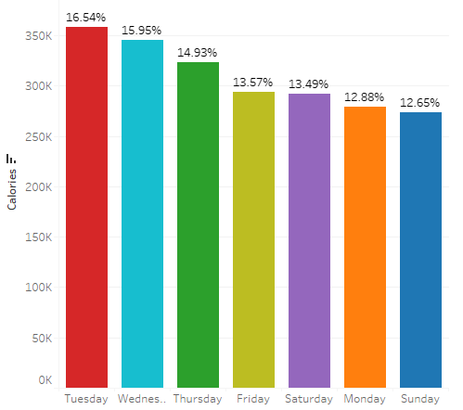
Average Calorie burn by Day of Week
The data shows that Tuesdays is the day with highest
average calorie burn, accounting for 16.54%.
On the other hand, Sundays has the lowest average
calorie burn at 12.65% of the total.
Weekdays show higher physical activity, while
weekends show lower activity.

Slide 4
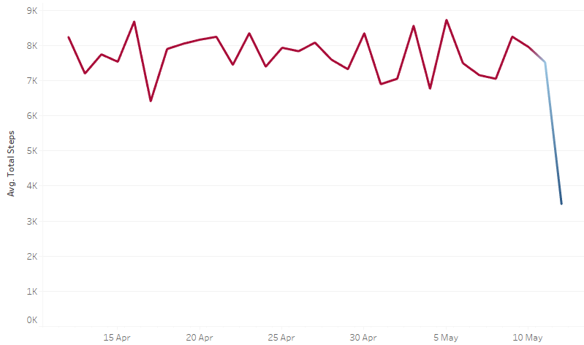
Average Steps Taken From April to May
The data is collected from non – bella beat users’
devices from April to May 2016.
Average of Total steps taken declined notably from April
to May according to the data analysis.
In April, the average total steps taken were around
8,000, while in May, it was less than 4,000.
This decline of about 50% in average total steps taken
may be due to weather changes, personal routines, or
other external factors.

Slide 5
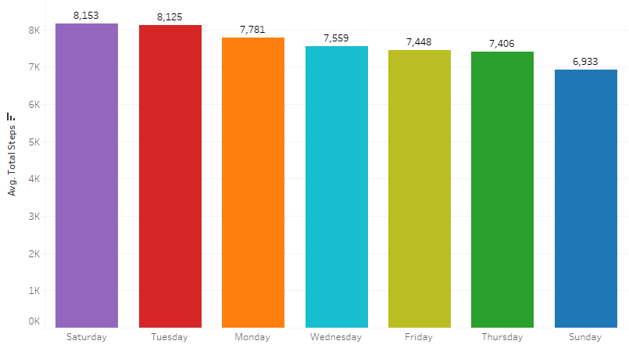
Average Total Steps Taken by Day of Week
Based on the analysis, the users walked on an
average of 8,153 steps on Saturdays.
In contrast, on Sundays, customers took the least
number of steps, which was about 6,933.
The data suggests that average step count decreases
as the weekend approaches, with the lowest activity
observed on Sundays.

Slide 6
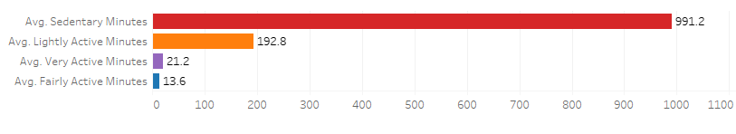
Average Total Steps Taken by Day of Week
Users’ spent an average of 991.2 minutes in sedentary mode, according to the analysis, indicating it was the most frequent behavior observed.
Users’ spent an average of only 13.6 minutes in fairly
active mode, indicating it was the least frequent
behavior observed.
The data underscores the importance of individuals being aware of their physical activity levels and actively working to decrease sedentary time while increasing active time.

Slide 7
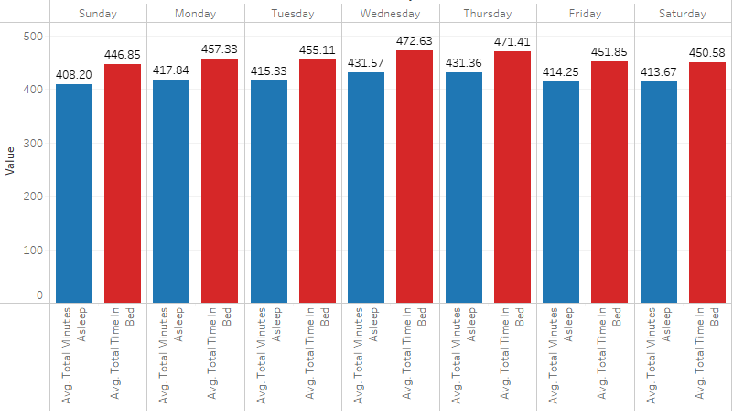
Sleep Duration and Bedtime Patterns
According to the analysis, on an average, users’ spent the most time sleeping on Wednesdays i.e. 431.7 minutes and the least time on Sundays i.e. 408.2 minutes.
The analysis also showed that users spent the longest time on their beds on Wednesdays i.e.
472.63 minutes and the shortest time on Sundays 446.85 minutes.
The data emphasizes the significance of quality sleep and consistent bedtime patterns for improved health and well-being.

Slide 8
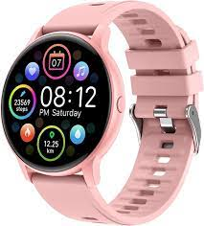
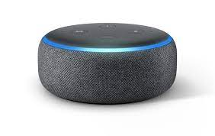
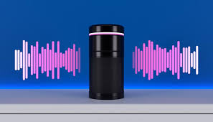
Applying Trends to Bella Beat Customers
Voice Assistant
Fitness Tracking
Smart Home
Integration
Bella Beat could incorporate more fitness tracking features into their smart products, catering to customers' health needs and lifestyle.
Bella Beat could integrate smart home automation features into their products for a more seamless and stress-free lifestyle.
Bella Beat could use voice assistants to provide a more hands-free experience for customers seeking a modern and convenient lifestyle.

Slide 9
Marketing Strategy Influence
Targeted Ads
Data on how consumers use non-Bella Beat smart devices can inform Bella Beat's targeted marketing strategies to reach broader audiences.
Product Design
Features informed by consumer insights may give Bella Beat an advantage in the market and appeal to a wider audience.
Brand Messaging
The value proposition of Bella Beat can be expanded to better fit the modern and convenient lifestyle that consumers are seeking with smart devices.
Social Media Campaigns
Bella Beat's marketing can leverage social media platforms to educate target audiences on the functionality and ease of smart devices.

Slide 10
Consumer Behaviour & Preferences
1
Privacy Concerns
While smart devices are popular, many consumers have expressed privacy concerns when it comes to data collection and use.
Design Aesthetics
2
Consumers are now more likely to choose a device that offers competitive features as well as an attractive design.
3
Price
Although feature set and design aesthetics are important, price is an important factor that influences their purchasing decision.

Slide 11
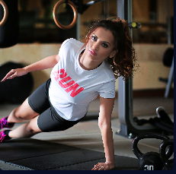


Bridging the Gap
Inclusivity
Demand Generation
Privacy
Privacy concerns can also be addressed through transparent communication and proactive privacy features built into the products.
Bella Beat could form partnerships with fitness influencers to create demand and drive sales of their new and improved fitness-focused smart device.
Bella beat's marketing campaigns could showcase a workforce that is friendly to women interested in technology to create a sense of inclusion and diversity for their female customers.

Slide 12
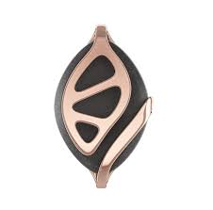
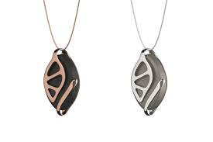
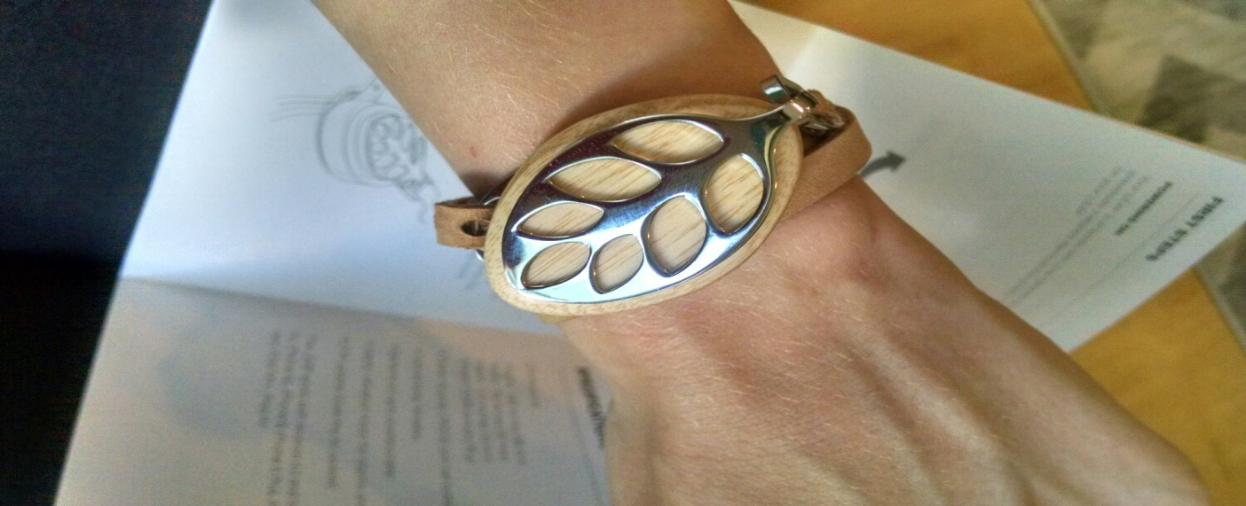
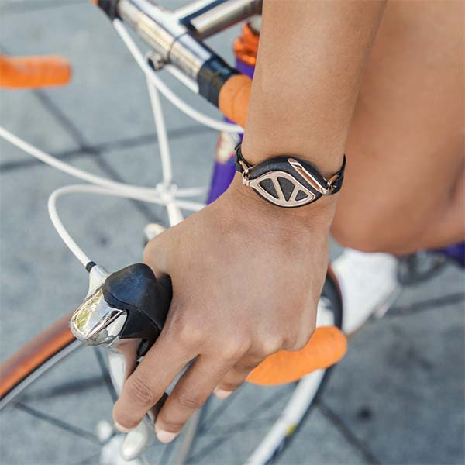
Innovation at Bella Beat : Bella Beat Leaf
Bella Beat is committed to delivering innovative, visually appealing, and functional smart devices for women's health and wellness, designed to meet women's connected health needs in a technology-driven environment.

Slide 13

The Future of Health & Wellness
As the world becomes more technology-driven, it's essential for companies like Bella Beat to stay ahead of the curve to meet the evolving health and wellness needs of their customers, through innovation and customer-focus.

